Slide 1

Research on Melodic Intervals in Vocal Parts of Jingju
Project for Audio and Music Processing Lab
Betty Cortiñas & Yuxi Qiao 02/03/2022

Slide 2
Table of Contents
Introduction
Research Question
Methodology & Results
Conclusion

Slide 3
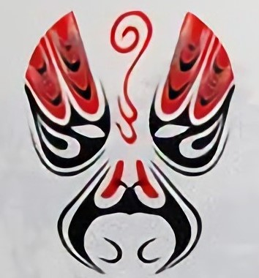
Introduction

Slide 4
Introduction
Jingju (Beijing Opera) was originated in Qing Dynasty (around 1790). Because Beijing was the capital of China then, outstanding opera artists all over the country came to Beijing, to make money, or play for the emperor, or develop their career. So, in Beijing, various types of local traditional operas integrated. Eventually, Jingju was formed and became the most influential traditional opera in China.
The main themes of Jingju are political and military struggles in history. Most stories are taken from historical romance and novel scripts. Where there is a story, there are characters. The role types of Jingju are as follows:
The gender of roles | Role type | Discription
Female | Dan (旦) | All female characters
Male | Jing (净) | Males with some peculiarity in character, quality, or appearance
 | Chou (丑) | Comic characters, like clowns.
 | Sheng (生) | Positive male characters other than Jing and Chou.

Slide 5
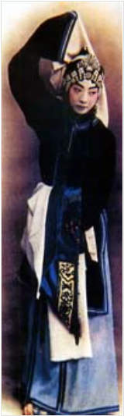
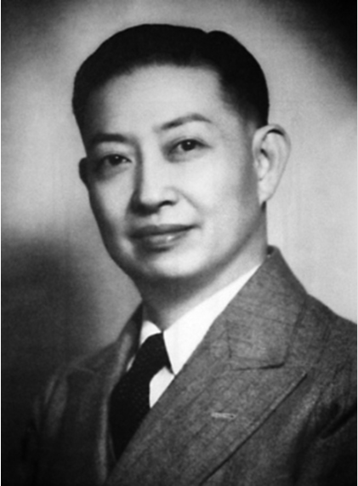
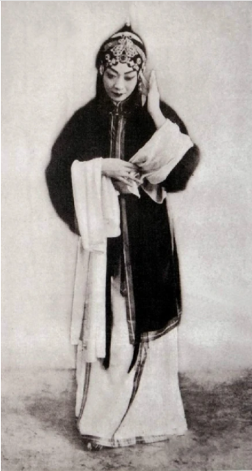
Introduction
“
The gender is simply refers to the characters in the play. It has nothing to do with the gender of the artists.
The gender of roles | Role type | Discription
Female | Dan (旦) | All female characters
Male | Jing (净) | Males with some peculiarity in character, quality, or appearance
 | Chou (丑) | Comic characters, like clowns.
 | Sheng (生) | Positive male characters other than Jing and Chou.
 | Laosheng (老生) | Sheng at an elderly age.

Slide 6
Introduction
Shengqiang (Melody)
Xipi and Erhuang are the most important Shengqiang in Jingju. Therefore, Jingju is also called Pihuang opera.
Xipi
Style: lively, vigorous, bright and light
Often to express cheerful, resolute, passionate and restrained feelings.
Erhuang
Style: peaceful, modest, lyrical
Often to express meditation, sadness, sigh and anger.

Slide 7
Research Question

Slide 8
Research Questions
“
“
State of the art literature refers to intervals mostly as an identifying characteristic of erhuang and xipi. [...] The major second is the most used interval in both cases, followed by the minor third.
One of the agreed differences between erhuang and xipi is the major use or larger intervals of the latter compared with the former.
What are the most frequent melodic motives of three notes in vocal parts?
Are they different between Erhuang and Xipi, or between Dan and Laosheng?
“
“
Male and female are very similar regarding the intervallic space, with a predominance of major seconds and minor thirds [...].
Female singing is usually “more melismatic”.
Caro Repetto, Rafael. (2018). The musical dimension of Chinese traditional theatre: An analysis from computer aided musicology [Zenodo]. https://doi.org/10.5281/zenodo.2030600

Slide 9
Methodology & Results

Slide 10
Methodology
Read all Jingju scores and extract sequences of three consecutive notes for the vocal parts:
Without any rests in the middle
Skipping grace notes (skipping to the next note to extract the interval)
Not considering unison intervals
Read scores_data.csv file and extract the Shengqiang for each score
Read lines_data.csv file and extract the Role Type for each line (offset of each note should be compared to Start and End offsets of each line in the .csv).
Save pair of intervals in each separate dictionary with keys in format: “{interval1_direction}{interval1_class}_{interval2_direction}{interval2_class}”, e.g. AM2_DM2
Plot bar graphs with percentage of each pair of intervals formed between the three consecutive notes:
First all the scores without making any distinction between Shengqiang or role.
Then separating between Erhuang and Xipi.
Then separating between Erhuang Dan, Erhuang Laosheng, Xipi Dan and Xipi Laosheng.

Slide 11
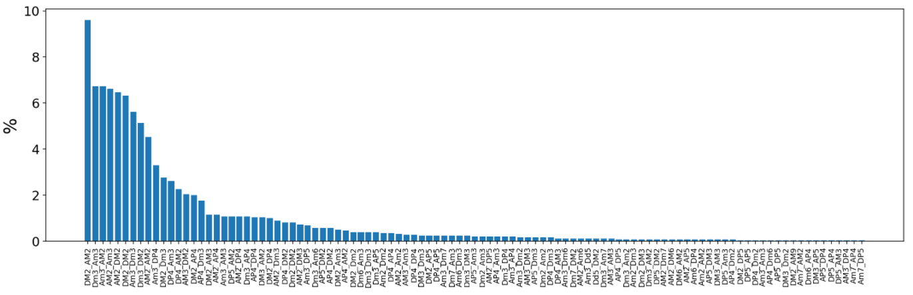
Results: All Scores
10 most frequent 3-note motives (in order) (symmetric melodic movements marked in blue):
DM2_AM2, Dm3_Am3, Am3_AM2, AM2_Am3, AM2_DM2, DM2_DM2, Am3_Dm3, Dm3_DM2, AM2_AM2, Am2_DP4
The most important intervals are Major Second and minor Third → natural intervals of the pentatonic scale.

Slide 12
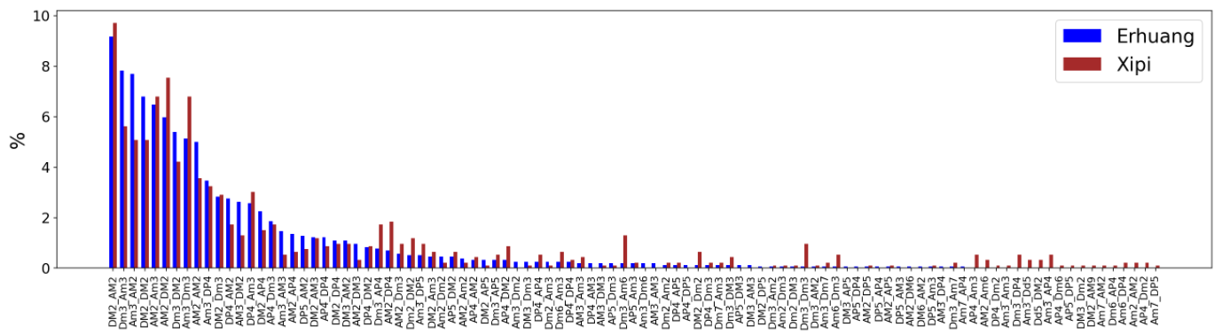
Results: Shengqiang
10 most frequent 3-note motives (in order) (symmetric melodic movements marked in blue):
Erhuang: DM2_AM2, Dm3_Am3, Am3_AM2, DM2_DM2, AM2_Am3, AM2_DM2, Dm3_DM2, Am3_Dm3, AM2_AM2, Am3_DP4
Xipi: DM2_AM2, AM2_DM2, Am3_Dm3, AM2_Am3, Dm3_Am3, Am3_AM2, DM2_DM2, Dm3_DM2, AM2_AM2, Am3_DP4
The most important intervals are Major Second and minor Third → natural intervals of the pentatonic scale.
Differences between Erhuang and Xipi:
In Xipi there are more types of combinations present between pairs of intervals than in Erhuang.
In Xipi there is a greater percentage of symmetric 3-note motives with M2 and m3 than in Erhuang.
In Xipi there is a slightly greater percentage of motives with intervals larger than M3 than in Erhuang, e.g. P4, P5, m6.

Slide 13
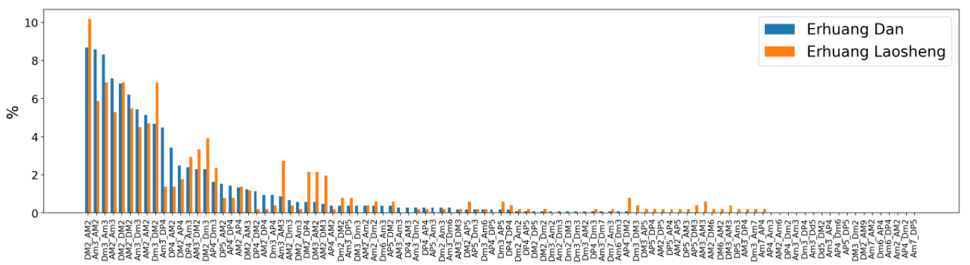
Results : Role type and Erhuang
10 most frequent 3-note motives (in order) (symmetric melodic movements marked in blue):
Erhuang Dan: DM2_AM2, Am3_AM2, Dm3_Am3, AM2_Am3, DM2_DM2, AM2_DM2, Am3_Dm3, AM2_AM2, Dm3_DM2, Am3_DP4
Erhuang Laosheng: DM2_AM2, Dm3_DM2, Dm3_Am3, DM2_DM2, Am3_AM2, AM2_DM2, AM2_Am3, AM2_AM2, Am3_Dm3, DM2_Dm3.
Differences between Erhuang Dan and Erhuang Laosheng:
In Erhuang Laosheng there are more types of combinations present between pairs of intervals than in Erhuang Dan.
In Erhuang Laosheng motives with M3 (e.g. Am3_AM3, DM3_AM2 and AM2_DM3) have more presence than in Erhuang Dan.

Slide 14
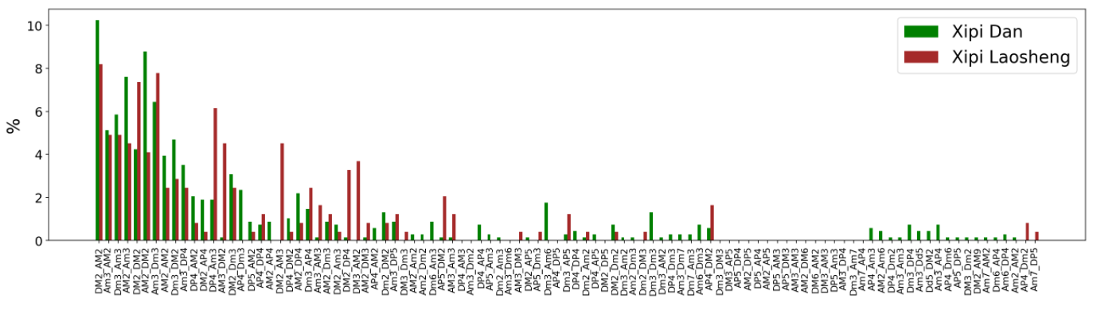
Results : Role type and Xipi
10 most frequent 3-note motives (in order) (symmetric melodic movements marked in blue):
Xipi Dan: DM2_AM2, AM2_DM2, AM2_Am3, Am3_Dm3, Dm3_Am3, Am3_AM2, Dm3_DM2, DM2_DM2, AM2_AM2, Am3_DP4
Xipi Laosheng: DM2_AM2, Am3_Dm3, DM2_DM2, DP4_AM3, Am3_AM2, Dm3_Am3, AM2_Am3, AM3_DM2, DM2_AM3, AM2_DM2
Differences between Xipi Dan and Xipi Laosheng:
In Xipi Dan there are more types of combinations present between pairs of intervals than in Xipi Laosheng.
In Xipi Laosheng motives combining M2 and M3 (e.g. AM3_DM2, DM2_AM3 and DM3_AM2) have more presence than in Xipi Dan.

Slide 15
Conclusion

Slide 16
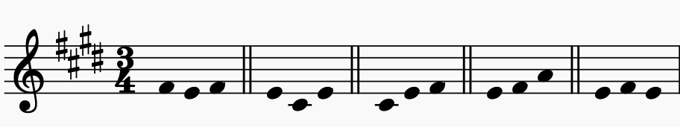
Conclusion
Male and female are very similar regarding the intervallic space, with a predominance of major seconds and minor thirds [...].
“
“
State of the art literature refers to intervals mostly as an identifying characteristic of erhuang and xipi. [...] The major second is the most used interval in both cases, followed by the minor third.
One of the agreed differences between erhuang and xipi is the major use or larger intervals of the latter compared with the former.
What are the most frequent melodic motives of three notes in vocal parts?
Second major and minor third are the most used intervals
2. Are they different between Erhuang and Xipi, or between Dan and Laosheng?
In Xipi there is more presence of 3-note motives with intervals larger than M3 than in Erhuang, e.g. P4, P5, m6.
In Xipi there are more types of combinations of 3-note motives..
In Xipi there is a greater percentage of symmetric 3-note motives with M2 and m3 than in Erhuang.
In Erhuang Laosheng there are more types of combinations present between pairs of intervals than in Erhuang Dan.
In Erhuang Laosheng motives with M3 have more presence than in Erhuang Dan.
In Xipi Dan there are more types of combinations present between pairs of intervals than in Xipi Laosheng.
In Xipi Laosheng motives combining M2 and M3 have more presence than in Xipi Dan.

